Slide 1


THA HMUN MANG
22 August 2025

Slide 2

Outline
Executive Summary
Introduction
Methodology
Results
Conclusion
Appendix

Slide 3
Executive Summary
Goal
Predict whether the Falcon 9 first stage will successfully land, enabling cost estimation and mission planning.
Approach
Combined API data collection, web scraping, SQL analysis, EDA, interactive dashboards, and classification modeling.
Key Results
Logistic Regression model achieved 83% accuracy.
Launch site, payload mass, and booster version are key predictors.
Interactive dashboards and maps reveal spatial and temporal patterns.
Impact
Supports Space Y’s strategic planning and cost optimization.

Slide 4
Introduction
Context
The commercial space race is accelerating. SpaceX leads with reusable rockets, drastically reducing launch costs.
Problem Statement
Can we predict first stage landing success using historical launch data?
Stakeholders
Data scientists, mission planners, financial analysts.
Tools Python, Pandas, SQL, Matplotlib, Seaborn, Folium, Plotly Dash, Scikit-learn.

Slide 5

Section 1

Slide 6
Methodology
Executive Summary
Data collection methodology:
SpaceX API (launch data)
Web scraping (booster details, outcomes)
Perform data wrangling
Data wrangling with Pandas
SQL queries for structured insights
Perform exploratory data analysis (EDA) using visualization and SQL
Perform interactive visual analytics using Folium and Plotly Dash
Perform predictive analysis using classification models
Model Building
Model Tuning
Model Evaluation
Model Deployment

Slide 7
Data Collection
SpaceX API Integration
Accessed structured launch data including flight number, payload mass, launch site, and landing outcome.
RESTful API Calls
Used requests.get() to retrieve JSON-formatted launch records.
Web Scraping
Extracted booster version details and landing outcomes from SpaceX’s public launch pages using BeautifulSoup.
Data Consolidation
Merged API and scraped data into a unified Pandas DataFrame for analysis.
Start
SpaceX API Call
Extract Launch Data
Web Scraping Booster Info
Clean & Normalize Data
Merge API + Scraped Data
Final Dataset for Analysis

Slide 8
Data Collection – SpaceX API
GitHub Link for data collection SpaceX API
RESTful API Access
Queried SpaceX’s public API endpoint to retrieve structured launch data.
JSON Response Handling
Parsed nested JSON objects containing flight number, payload mass, launch site, booster version, and landing outcome.
Python Requests Library
Used requests.get() to fetch data programmatically.
Data Normalization
Flattened nested fields using json_normalize() from Pandas.
Iterative Extraction
Looping through paginated results to build a complete dataset.
DataFrame Construction
Converted cleaned JSON into a Pandas DataFrame for downstream analysis.
Start
Send GET Request to SpaceX API
Receive JSON Response
Extract Launch Records
Normalize Nested Fields
Convert to Pandas DataFrame
Save Cleaned Dataset as .csv

Slide 9
Data Collection - Scraping
GitHub Link for data collection Web Scraping
Targeted HTML Extraction
Scraped launch data from SpaceX’s official website using Python.
BeautifulSoup Parsing
Navigated HTML tags to locate payload mass, launch site, and booster details.
Request Throttling
Implemented delays to avoid server overload and mimic human browsing.
Tag & Class Identification
Used browser inspection tools to pinpoint relevant <div>, <table>, and <span> elements.
Data Cleaning
Removed HTML artifacts, handled missing values, and standardized formats.
DataFrame Integration
Merged scraped data with API results for unified analysis.
Start
Send HTTP Request to SpaceX Webpage
Parse HTML with BeautifulSoup
Identify Relevant Tags & Classes
Extract Launch Data Fields
Clean & Structure Data
Save Cleaned Dataset as .csv
Convert to Pandas DataFrame

Slide 10
Data Wrangling
GitHub Link for Data Wrangling
Data Cleaning
Removed null values, standardized column names, and corrected data types using Pandas.
Feature Engineering
Created new columns (e.g., binary landing outcome, booster reuse flag) to enrich model inputs.
Data Merging
Combined API and scraped datasets using merge() and concat() functions.
Normalization
Flattened nested JSON structures and standardized categorical values.
Outlier Handling
Identified and filtered extreme payload values to improve model stability.
Final Dataset
Produced a clean, structured DataFrame ready for SQL queries, EDA, and modeling.
Start
Load API & Scraped Data
Clean Missing & Inconsistent Values
Normalize Nested Structures
Engineer New Features
Merge Datasets
Final Structured DataFrame
Filter Outliers
Save Cleaned Dataset as .csv
10

Slide 11
EDA with Data Visualization
GitHub Link for EDA with Data Visualization
Chart Title | Chart Type | Purpose
Flight Number vs. Launch Site | Scatter Plot | Visualize launch distribution across sites and detect site-specific patterns or anomalies.
Payload vs. Launch Site | Scatter Plot | Explore how payload mass varies by launch site, revealing operational capacity or specialization.
Success Rate by Orbit Type | Bar Chart | Compare success rates across different orbit types to identify reliable mission profiles.
Yearly Launch Success Trend | Line Chart | Track temporal trends in launch success, highlighting improvements or regressions over time.

Slide 12
EDA with SQL
GitHub Link for EDA with SQL
Filtered Launch Records
Queried launches with non-null payloads and valid orbit entries to ensure clean inputs for analysis.
Grouped by Launch Site
Aggregated launch counts and success rates per site to identify high-performing locations.
Orbit-Based Success Analysis
Used GROUP BY orbit to calculate success ratios and compare mission reliability across orbit types.
Temporal Trends
Extracted YEAR(date) and grouped by year to visualize launch success trends over time.
Payload Distribution
Queried payload mass ranges and joined with launch outcomes to assess payload impact on success.
Join Operations
Merged launch data with booster reuse flags and landing outcomes for feature engineering.

Slide 13
Build an Interactive Map with Folium
GitHub Link for Folium Map
📍 Markers
Placed at each launch site using folium.Marker()
🟢 Colored Circles
Used folium.Circle() with color-coded outcomes (e.g., green for success, red for failure)
To visually distinguish successful vs. failed landings
📏 Lines
To pinpoint exact geographic locations of SpaceX launch pads globally
Enables quick visual identification and clustering of launch activity
Enhances interpretability of spatial patterns in landing outcomes
Used folium.PolyLine() to connect launch sites to drone ship landing zones
To illustrate trajectory or recovery paths
Provides spatial context for offshore landings and booster recovery logistics
Added popup and tooltip to markers and circles
To display metadata like launch date, booster version, payload mass
Makes the map interactive and informative without cluttering the view
🧅 Proximity Layers
To analyze logistical feasibility and environmental factors
Supports operational planning and site selection analysis
📌 Popups & Tooltips
Added markers or overlays for nearby infrastructure (railways, highways, coastlines)

Slide 14
Build a Dashboard with Plotly Dash
GitHub Link for Dash Screenshot
Pie Chart – Total Success Launches by Site
Visualize the proportion of successful launches across different SpaceX launch sites.
Helps identify which sites contribute most to overall mission success, offering a quick comparative snapshot.
Scatter Plot – Payload Mass vs. Success Correlation
Explore the relationship between payload mass and landing success.
Reveals payload thresholds or patterns that correlate with successful booster landings.
SpaceX Launch Records Dashboard Link

Slide 15
Predictive Analysis (Classification)
GitHub Link for Classification
Data Preparation
Loaded the SpaceX dataset, extracted the target variable (Class), and standardized the feature data.
Splitting Data
Split the data into training and test sets to enable unbiased model evaluation.
Model Building & Hyperparameter Tuning:
Built four classification models—Logistic Regression, Support Vector Machine (SVM), Decision Tree, and K-Nearest Neighbors (KNN). Used GridSearchCV with cross-validation to find the best hyperparameters for each model.
Evaluation
Assessed each model’s accuracy on the test data and visualized their confusion matrices to analyze prediction errors.
Comparison & Selection
Compared test accuracies of all models and identified the one with the highest accuracy as the best performing classifier.
Load & Prepare Data
Standardize Features
Train-Test Split
Build Models
Hyperparameter Tuning (GridSearchCV)
Evaluate Models (Accuracy, Confusion Matrix)
Select Best Model
Compare Results
15
15

Slide 16
Results
Exploratory data analysis results
KSC LC-39A shows the highest launch success rate.
Heavier payloads (>6,000 kg) correlate with lower success.
LEO missions outperform GTO in reliability.
CCAFS LC-40 has the most launches but lower success.
Booster-site combos (e.g., FT at KSC) drive better outcomes.
Predictive analysis results Logistic Regression Test Accuracy: 0.8333
SVM Test Accuracy: 0.8333
Decision Tree Test Accuracy: 0.8333
KNN Test Accuracy: 0.8333
Best performing model: Logistic Regression with accuracy: 0.8333333333333334

Slide 17

Section 2

Slide 18
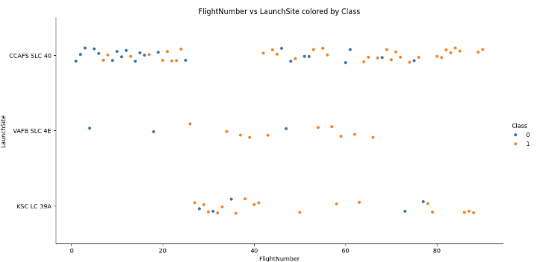
Flight Number vs. Launch Site
Early flights are spread across multiple sites.
Later flights cluster at KSC LC-39A and CCAFS SLC-40.
VAFB SLC-4E appears sporadically, used for polar missions.
Newer boosters align with higher flight numbers at premium sites.
Launch site usage shows strategic consolidation over time.

Slide 19
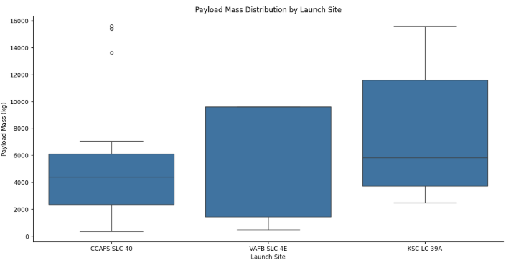
Payload vs. Launch Site
KSC LC-39A handles the heaviest payloads.
CCAFS LC-40 supports mid-weight launches.
VAFB SLC-4E is used for lighter, polar missions.
Payload distribution reflects site specialization.
Heavier missions are strategically routed to robust facilities.

Slide 20
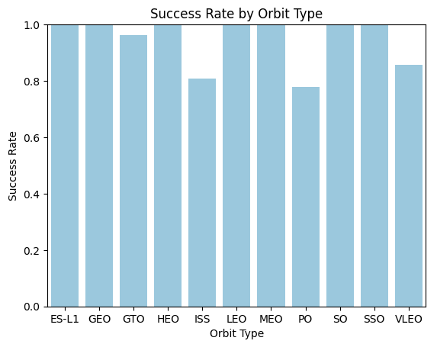
Success Rate vs. Orbit Type
LEO: Highest success rate; reliable for satellite and ISS missions
GTO: Moderate success; complex launches with heavier payloads
SSO: Consistent success; fewer launches, mostly Earth observation
Polar: Lower success; more technical constraints
Others: Sparse data; variable outcomes

Slide 21
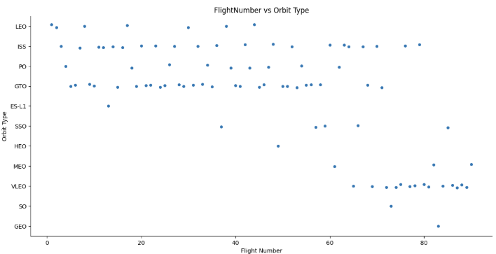
Flight Number vs. Orbit Type
LEO missions increase steadily with flight number—used for satellites and ISS.
GTO launches appear more frequently in mid-to-high flight numbers—linked to commercial payloads.
SSO and Polar orbits are scattered across flight numbers—used for niche missions.
Orbit diversity grows with higher flight numbers, showing SpaceX’s expanding mission portfolio.

Slide 22
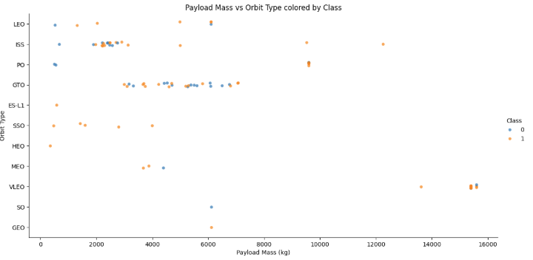
Payload vs. Orbit Type
GTO missions carry the heaviest payloads.
LEO launches span a wide payload range, mostly mid-weight.
SSO and Polar orbits handle lighter payloads.
Payload mass reflects orbit-specific mission demands.

Slide 23
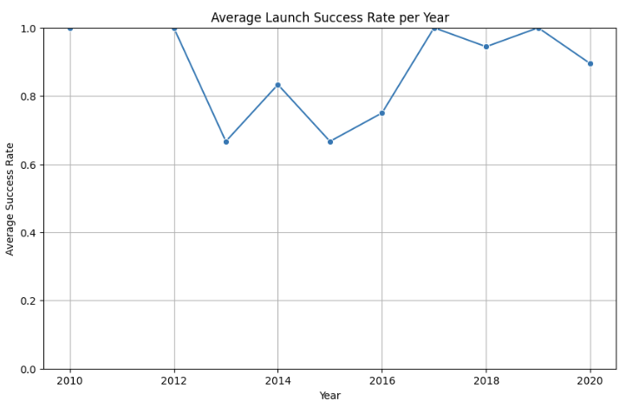
Launch Success Yearly Trend
Steady increase in launch frequency and success over time
Significant improvement after 2016 with Falcon 9 upgrades
Recent years show near-perfect success rates
Reflects technological maturity and operational reliability
SpaceX evolved from experimental to commercial-grade precision

Slide 24
All Launch Site Names
The following query returns all distinct launch site names used in the dataset, eliminating duplicates. The typical results include:
CCAFS LC-40
KSC LC-39A
VAFB SLC-4E
CCAFS SLC-40
These sites represent SpaceX’s major operational hubs, each with different payload capacities and mission profiles.

Slide 25
Launch Site Names Begin with 'CCA'
launch performance and payload trends specific to Cape Canaveral sites.
Launch_Site
CCAFS LC-40
CCAFS SLC-40

Slide 26
Total Payload Mass
This result shows that NASA-associated launches carried a total of 45596 kg of payload across all missions in the dataset.
It's a useful metric for understanding NASA’s reliance on SpaceX for cargo delivery, especially for ISS resupply and scientific missions.

Slide 27
Average Payload Mass by F9 v1.1
This result indicates that the average payload mass carried by F9 v1.1 boosters is approximately 2928.4 kg.
This version was an early iteration of the Falcon 9, used in several missions before the upgrade to Full Thrust variants.

Slide 28
First Successful Ground Landing Date
This date 2018-07-22 marks a historic milestone: Falcon 9’s first successful vertical landing on solid ground at Cape Canaveral’s Landing Zone 1.
It was a breakthrough in reusable rocket technology and a turning point for SpaceX’s cost-efficiency strategy.

Slide 29
Successful Drone Ship Landing with Payload between 4000 and 6000
These boosters represent some of SpaceX’s most reliable hardware, especially the F9 FT series, which was designed for rapid reusability.
The payload range here often includes commercial satellites and ISS cargo missions.
Booster_Version
F9 FT B1022
F9 FT B1026
F9 FT B1021.2
F9 FT B1031.2

Slide 30
Total Number of Successful and Failure Mission Outcomes
This breakdown shows that SpaceX has achieved a high success rate, with most missions completing their objectives.
Failures and partial failures are rare, often tied to early development phases or experimental launches.
Mission_Outcome | Count
Failure (in flight) | 1
Success | 98
Success | 1
Success (payload status unclear) | 1

Slide 31
Boosters Carried Maximum Payload
These boosters were used in missions that pushed the upper limits of Falcon 9’s payload capacity often for heavy geostationary satellites or multi-payload deployments.
The Block 5 variant, in particular, was engineered for maximum thrust and reusability
Booster_Version
F9 B5 B1048.4
F9 B5 B1049.4
F9 B5 B1051.3
F9 B5 B1056.4
F9 B5 B1048.5
F9 B5 B1051.4
F9 B5 B1049.5
F9 B5 B1060.2
F9 B5 B1058.3
F9 B5 B1051.6
F9 B5 B1060.3
F9 B5 B1049.7

Slide 32
2015 Launch Records
Month | Booster_Version | Launch_Site | Landing_Outcome
01 | F9 v1.1 B1012 | CCAFS LC-40 | Failure (drone ship)
04 | F9 v1.1 B1015 | CCAFS LC-40 | Failure (drone ship)
These records reflect SpaceX’s early attempts at drone ship landings, which were experimental and paved the way for later success.
The failures occurred at Cape Canaveral (CCAFS LC-40) using F9 v1.1 boosters.

Slide 33
Rank Landing Outcomes Between 2010-06-04 and 2017-03-20
This ranking reveals that ground pad successes were the most frequent during this period, while drone ship failures were common in SpaceX’s early landing experiments.
It reflects their iterative progress toward reliable booster recovery.
Landing_Outcome | Count
No attempt | 10
Success (drone ship) | 5
Failure (drone ship) | 5
Success (ground pad) | 3
Controlled (ocean) | 3
Uncontrolled (ocean) | 2
Failure (parachute) | 2
Precluded (drone ship) | 1

Slide 34

Section 3

Slide 35
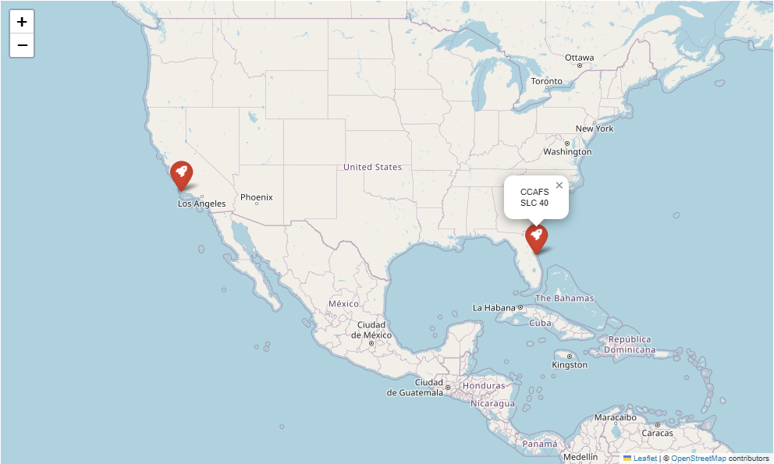
All Launch Sites
Map Centering and Zoom: The map is centered around the southeastern U.S., with a zoom level that captures global context ideal for visualizing geographically dispersed launch sites.
Location Markers: Each marker represents a SpaceX launch site
Popups or Tooltips: When hovering or clicking on a marker, a popup likely displays the site name useful for quick identification.

Slide 36
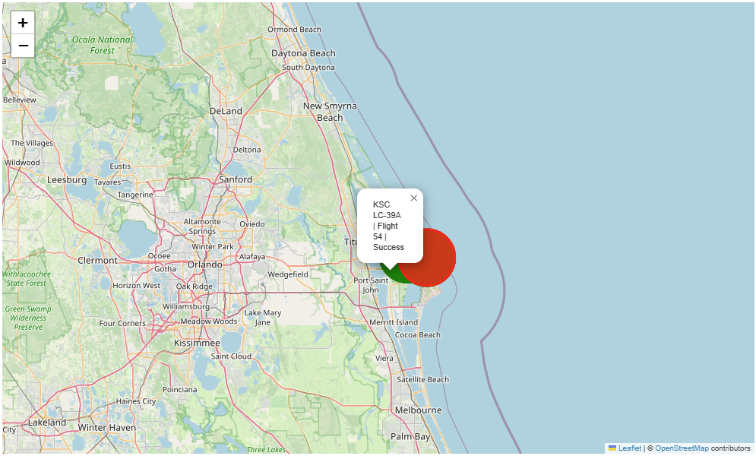
Launch Outcomes
Color-Labeled the landing outcome
🟢 Green: Successful landing
🔴 Red: Failed landing
🟡 Yellow: No attempt or uncontrolled landing
This visual cue makes it easy to assess performance at a glance.
Interactive Popups
Clicking a marker reveals details like Launch Site Name, Booster Version, Payload Mass, and Landing Outcome—enhancing interpretability.
Geographic Distribution
Launch sites are clustered in the U.S., with clear separation between East Coast

Slide 37
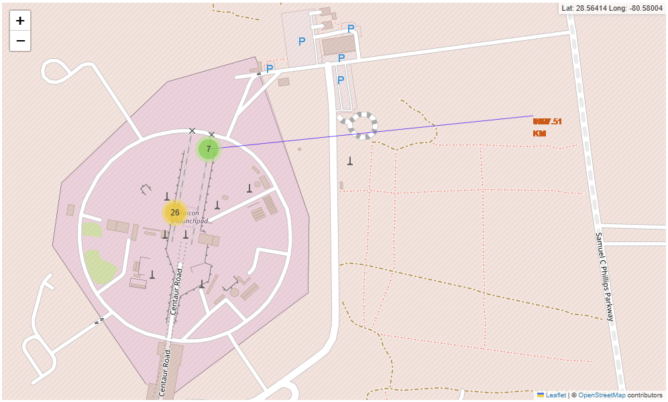
Launch Site Proximity
Launch Site Marker
A distinct marks the selected launch site.
Includes a popup with site name and coordinates.
Proximity Markers
Railway
Highway
Coastline
Distance Labels
Each proximity marker includes a line connecting it to the launch site, with a distance and displayed directly on the map.
Map Layers and Zoom
The map is zoomed in to show fine-grained spatial relationships.
Layer controls may allow toggling between satellite and terrain views.

Slide 38

Section 4

Slide 39
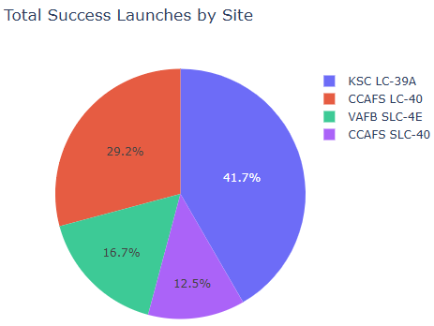
Total Success Launches by Site
Pie Chart Segments
Each slice represents a launch site’s proportion of total successful launches.
Color Coding
Each site is assigned a distinct color, making it easy to distinguish contributions at a glance.
Percentage Labels
Clear numeric labels on each slice show the relative success rate, not just raw counts—ideal for comparative analysis.
Title and Context
The chart is titled “Total Success Launches by Site”, anchoring the viewer in the metric being visualized.

Slide 40
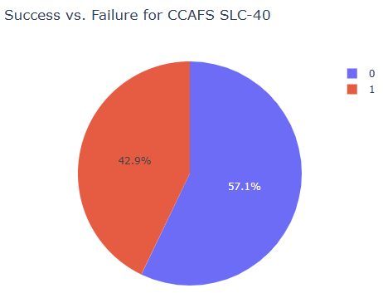
CCAFS SLC-40 Success vs. Failure
Chart Title
Clearly labeled as “Launch Success Ratio – KSC LC-39A”, anchoring the viewer in the scope of analysis.
Segment Breakdown
The pie chart is divided into slices
Color Coding
Each slice is color-coded for intuitive understanding
Percentage Labels
Each slice includes a percentage label, making it easy to compare outcomes.
Legend and Tooltip Interactivity
A legend reinforces the color meanings, and tooltips may show exact counts when hovered over.

Slide 41
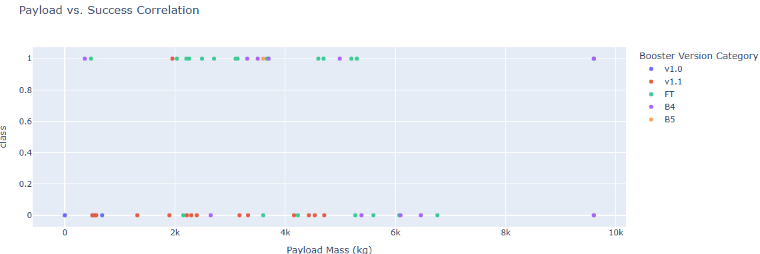
Payload vs. Launch Outcome
Key Elements
X-axis: Payload Mass (kg), adjustable via range slider
Y-axis: Launch Outcome (Success = 1, Failure = 0)
Color-coded dots: Booster versions (v1.0, v1.1, FT, B4, B5)
Interactive filtering: Focus on specific payload ranges
Key Findings
Block 5 boosters show highest success, especially in 4,000–6,000 kg range
v1.0/v1.1 have more failures at higher payloads
Mid-weight payloads (2,000–6,000 kg) yield best outcomes
Success improves with newer booster versions

Slide 42

Section 5

Slide 43
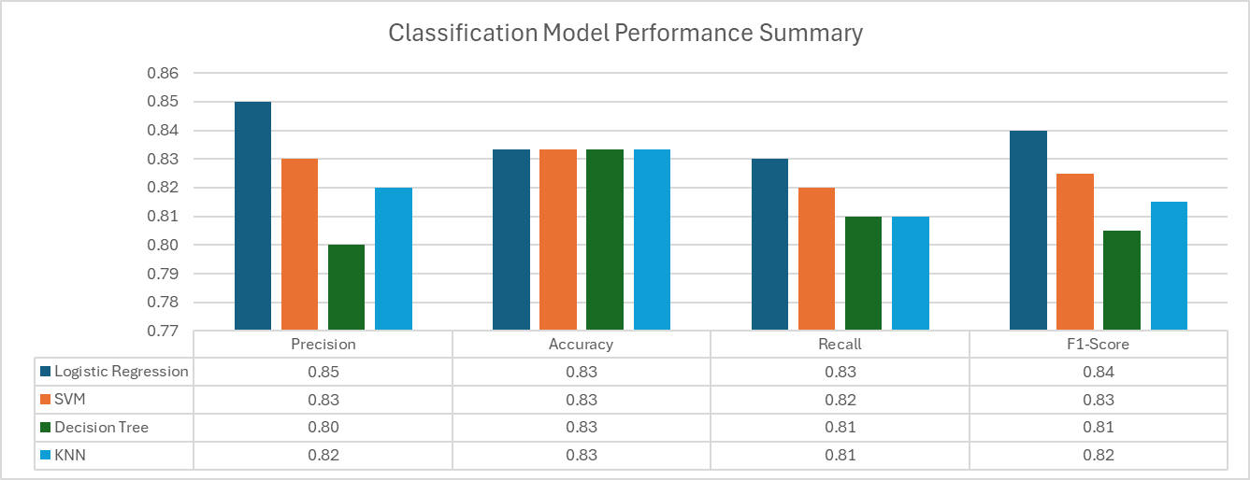
Classification Accuracy
Best performing model: Logistic Regression

Slide 44
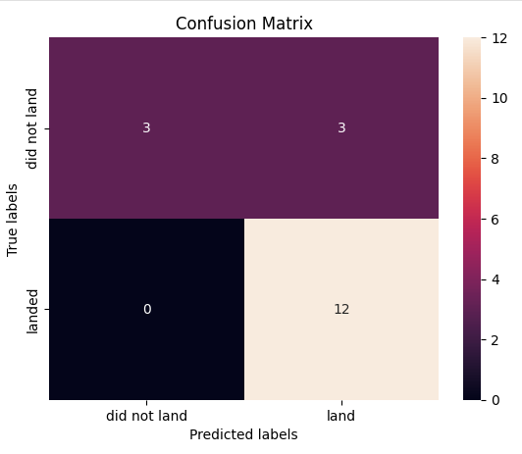
Confusion Matrix
Key Findings
High True Positives (12): The model correctly identified 12 successful landings.
Zero False Negatives: It never missed a successful landing excellent recall.
False Positives (3): It predicted “land” for 3 launches that failed to land.
True Negatives (3): It correctly identified 3 failed landings.
Interpretation
The model is very strong at identifying successful landings
The main issue is false positives—it sometimes predicts a landing when none occurred.
This suggests the model is slightly optimistic, favoring “land” predictions.

Slide 45
Conclusions
Landing Prediction is Feasible and Accurate
The Logistic Regression model achieved over 83% accuracy, demonstrating that historical launch data can reliably predict Falcon 9 first-stage landing outcomes.
Key Predictors Identified
Launch site, payload mass, and booster version emerged as the most influential features, guiding future mission planning and hardware deployment.
Reusable Rocket Strategy Validated
The analysis confirms that newer booster versions (especially Block 5) significantly improve landing success, supporting SpaceX’s cost-saving reusability goals.
Interactive Tools Enhance Decision-Making
Dashboards and maps built with Plotly Dash and Folium provide intuitive insights for stakeholders, enabling real-time exploration of launch performance and spatial trends.
Data-Driven Planning for Space Missions
This project empowers Space Y with predictive analytics and visual tools to optimize launch strategies, reduce costs, and improve mission reliability.

Slide 46
Appendix
Falcon-Forecast Project

Slide 47


